Slide 1
Lecture-2
Principles of Accounting
Financial Statements

Slide 2
Types of Business Organizations
Proprietorships
Partnerships
Corporations

Slide 3
Sole Proprietorship
The term Sole refers to one or single
The term proprietorship refers to owner or ownership.
The sole proprietorship is an enterprise which has only one owner referred to as sole proprietor.
From accounting stand point the sole proprietorship is viewed as a business entity separate from personal affairs of owner.
From legal stand point proprietor is personally responsible for all debts of the business.

Slide 4
Proprietorships
Advantages
  Total undivided authority
  No restrictions on type of business – must be legal
Disadvantages
  Unlimited liability- bankruptcy
  Limitation on size – fund raising power

Slide 5
Partnerships
A business owned by two or more persons voluntarily acting as partners.
Widely used for small businesses.
From accounting stand point the partnership is viewed as a business entity separate from personal affairs of partners.
Like sole proprietorship owners of the partnership are personally responsible for all debts of the business.

Slide 6
Partnerships
Advantages
  Better credit standing – possibly
  The ability to bring together larger amounts of capital investment.
  More brain power, but consultation with partners required
Disadvantages
  Unlimited personal liability for general partners
  Need for written partnership agreement

Slide 7
Corporations
Only Business recognized under law as an entity separate from its owners.
Owners of corporation are not personally responsible for the debts of the business.
The owners lose not more than the amount invested in the business- limited liability.
Ownership is divided into transferable shares of capital stock.
Owners are called stockholders.
Stock certificates are issued by the corporation to the stock holder showing the number of shares that he or she owns.
Transfer of shares to other investors.
Ability to bring together large investments.

Slide 8
Corporations
Advantages
  Separate legal existence
  Limited liability of stockholders
  Transferability of ownership relatively easy
Disadvantages
  Taxes – possible double taxation
  Extensive governmental regulation

Slide 9
Types of Business &
Equity Section of Balance Sheet
Owner’s Equity (For Sole Proprietorship)
  Michael McBryan, Capital………. $ 40,000
Partners’ Equity (For Partnership)
  Michael McBryan, Capital………. $ 40,000
  Rebecca McBryan, Capital………$ 40,000
Stockholders Equity (For Corporation)
  Capital Stock ……………………..$ 80,000
  Retained Earnings ……………… $ 1,000
  Total Stockholders’ Equity….. $ 81,000

Slide 10
Solvency & Profitability
Short Term Verses Long Term
  In short run solvency & profitability may be independent of each other
  In long run they go hand in hand
Evaluating Short Term Solvency
  Liquid Assets Vs Liabilities

Slide 11
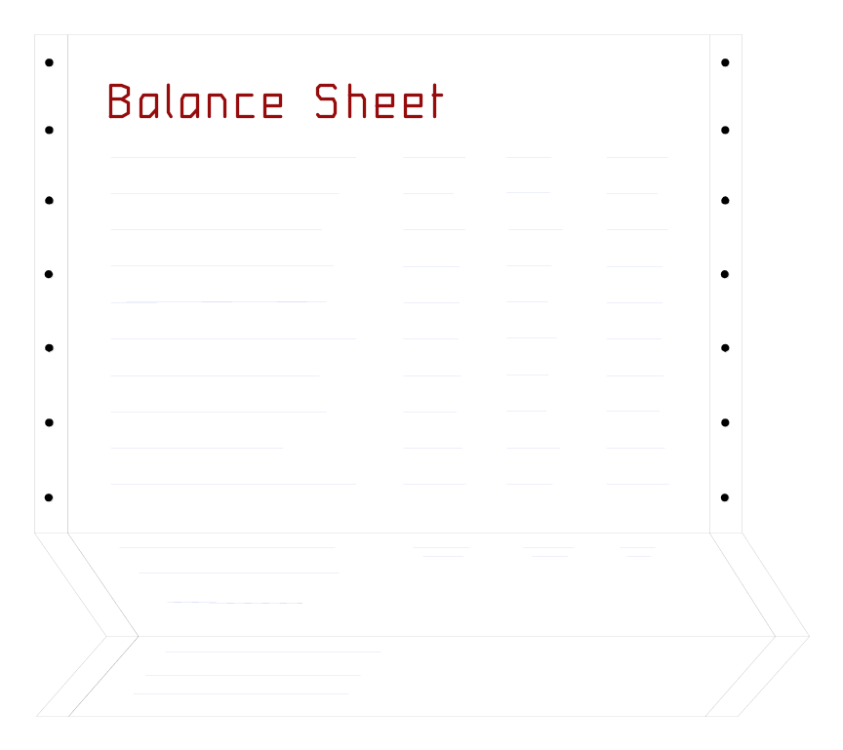
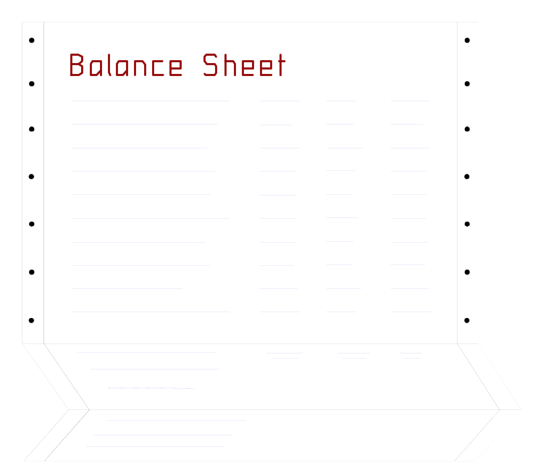

Introduction to Financial Statements
Three primary financial statements.
Balance Sheet
Income Statement
Statement of Cash Flows
We will use a corporation to describe these statements.
Notes:
There are three fundamental financial statements used in accounting.
The income statement shows our revenues and expenses.
The balance sheet is a listing of all asset, liability, and equity account balances that do not appear on the income statement.
The statement of cash flows shows where the company gets and spends its cash.
In this chapter, we also will look at the financial statements of a corporation.

Slide 12
Introduction to Financial Statements
Describes where the enterprise stands at a specific date.
Balance Sheet
Income Statement
Statement of Cash Flows
Notes:
The balance sheet describes the financial position of the company at a specific point in time. We may prepare a balance sheet monthly, quarterly, or annually depending on the needs of management and external users.

Slide 13
Introduction to Financial Statements
Balance Sheet
Depicts the revenue and expenses for a designated period of time.
Income Statement
Statement of Cash Flows
Notes:
Net income is defined as the excess of revenues over expenses. Financial statements have a three-line title with the company name, the name of the statement, and the period covered by the report. The income statement lists revenues and expenses that were incurred over a period of time. Most companies prepare monthly income statements.

Slide 14
Introduction to Financial Statements
Balance Sheet
Income Statement
Statement of Cash Flows
Depicts the ways cash has changed during a designated period of time.
Notes:
We will cover the statement of cash flows in detail in a later chapter. The statement of cash flows is divided into three major sections: (1) cash flows from operating activities; (2) cash flows from investing activities, and (3) cash flows from financing activities. The statement describes cash inflows and outflows over a period of time.

Slide 15
Balance Sheet
It is a statement that describes where an enterprise stand at a specific date.
The date is important as the financial position of a business may change quickly.
Every business prepares a balance sheet at the end of the year, and many companies prepare one at the end of each month, week or even day.

Slide 16
Balance Sheet
Main Contents:
      Assets
      Liabilities
      Owner’s Equity
Based on Accounting Equation:
      Assets = Liabilities + Owner’s Equity

Slide 17
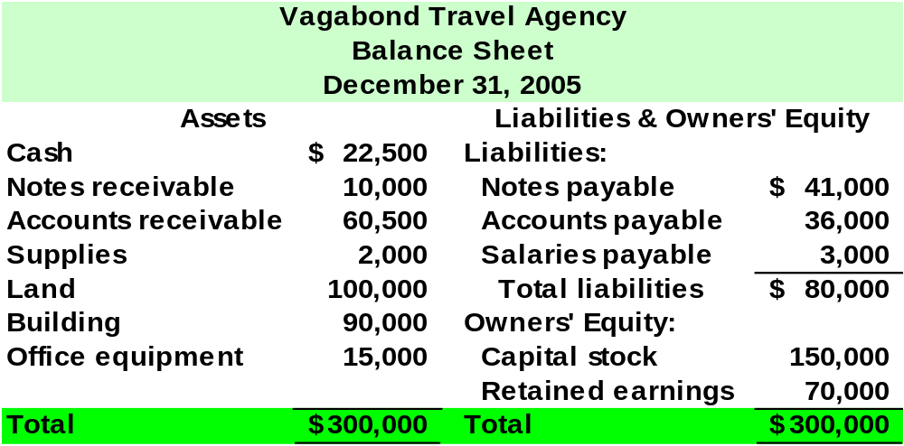

A Starting Point: Statement of Financial Position
Notes:
The balance sheet is an inventory of assets, liabilities and equity at the end of the month. Our total assets are equal to three hundred thousand dollars. This includes cash of twenty-two thousand five hundred dollars, notes receivable of ten thousand dollars, supplies of two thousand dollars, and the balances in the remaining asset accounts.
Liabilities include notes payable of forty-one thousand, accounts payable of thirty-six thousand and salaries payable of three thousand dollars. The accounts in the owners’ equity section of the balance sheet are capital stock of one hundred-fifty thousand dollars and retained earnings of seventy thousand dollars.
Notice that the total assets are equal to the total liabilities plus owners’ equity.

Slide 18
Balance Sheet - Assets
Assets: These are economic resources that are owned by a business and are expected to benefit future operations.
Assets result in positive future cash flows directly or indirectly.
    Direct Positive Future Cash Flow: Asset converted into cash (Collection of an Accounts Receivable).
    Indirect Positive Future Cash Flow: Machinery used to manufacture a product for sale.

Slide 19
Valuation of Assets in Balance Sheet
The Cost Principle: Assets such as land, buildings, merchandise are shown at the original amount that the business paid to acquire the asset.
The Objectivity Principle: One of the reason for using cost rather than current market values in account for most assets is the need for a definite, factual basis for valuation. Market values are constantly changing.

Slide 20
Balance Sheet - Liabilities
Liabilities : are financial obligations or debts.
They represent negative future cash flows for the enterprise.
They are listed in the order in which they are expected to be repaid.
Liabilities represent claims against the borrower’s assets. In the eyes of law, creditor's claims take priority over those of the owners.

Slide 21
Balance Sheet – Owner’s Equity
Owner’s Equity: represents the owner’s claims on the assets of the business.
Because liabilities or the creditor’s claims have legal priority over those of the owners, owner’s equity is the residual amount.

Slide 22
Balance Sheet – Owner’s Equity
Increases in Owner’s Equity:
  Investments of cash or other assets by owners.
  Earnings from profitable operation of the business.
Decreases in Owner’s Equity:
  Payments of cash or transfers of other assets to owners.
  Losses from unprofitable operation of the business.

Slide 23
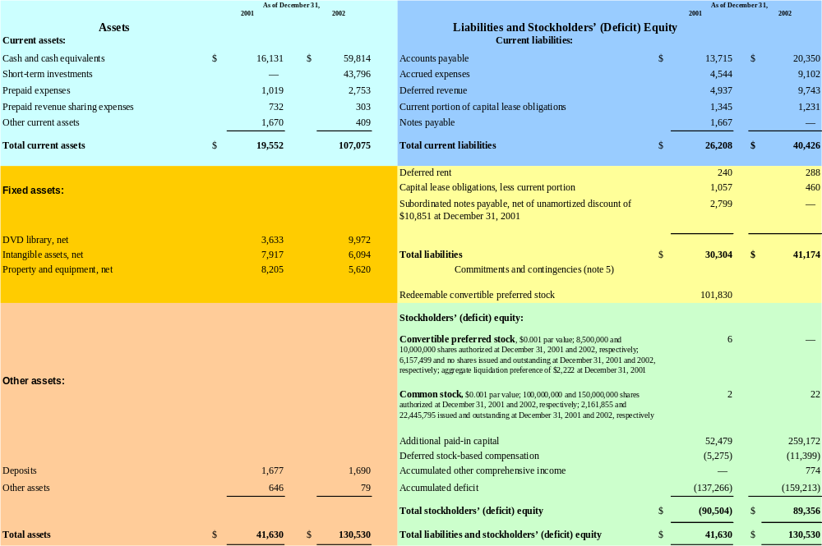
The Balance Sheet
Liquidity
Current Assets
Current Liabilities
Long-Term Liabilities
Fixed Assets
Equity Section
Other Assets
Notes:
Normally people think of left side (assets) vs. right side (liabilities).
The most current assets/liabilities near the top with less liquid at bottom
MUST FOOT – easy, but watch for it.

Slide 24
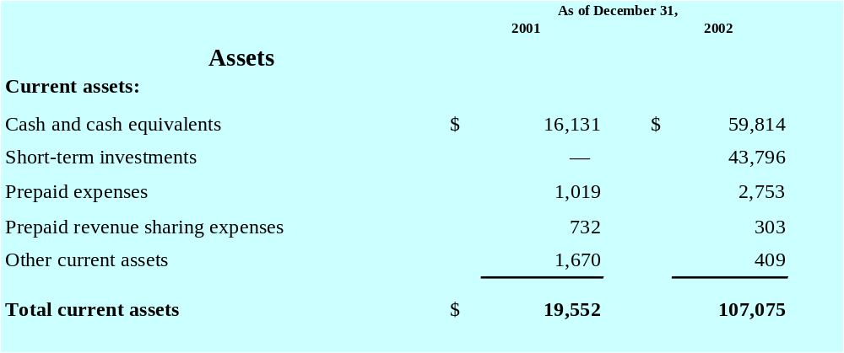
The Balance Sheet – Current Assets
Also: A/R & Inv
Notes:
Normally people think of left side (assets) vs. right side (liabilities).
The most current assets/liabilities near the top with less liquid at bottom
MUST FOOT – easy, but watch for it.

Slide 25
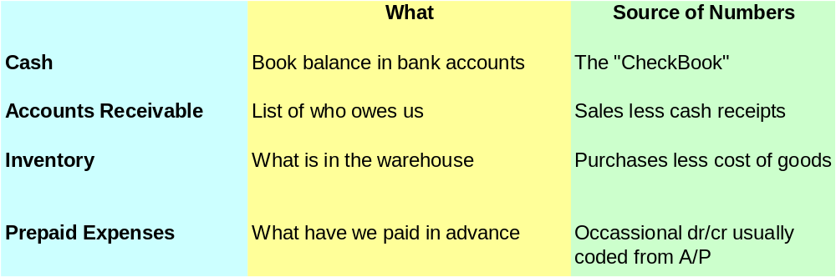
Dissecting the Balance Sheet – Left Side Thinking – Current Assets
Current Assets
Notes:
Valuation Issues:
Market vs. Cost
Going Concern vs. Liquidation Value

Slide 26
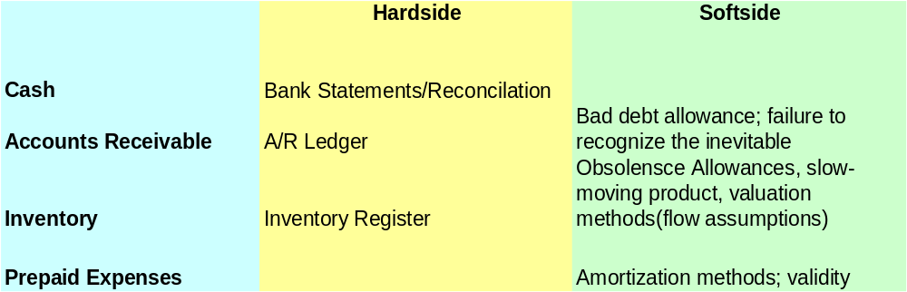
Dissecting the Balance Sheet – Left Side Thinking – Current Assets
Current Assets
Notes:
Valuation Issues:
Market vs. Cost
Going Concern vs. Liquidation Value

Slide 27
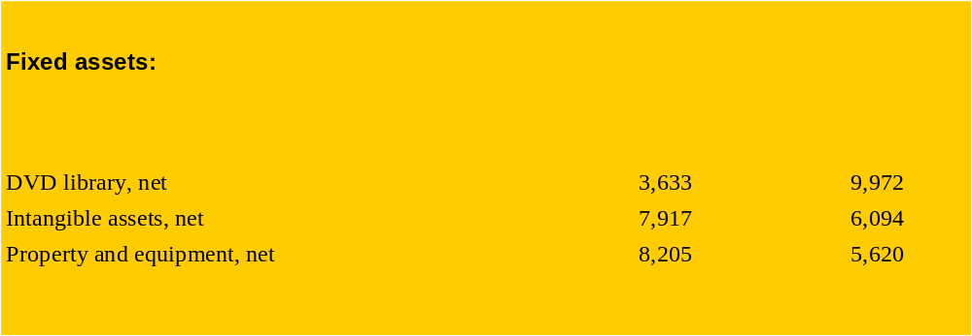
The Balance Sheet – Fixed Assets
Notes:
Normally people think of left side (assets) vs. right side (liabilities).
The most current assets/liabilities near the top with less liquid at bottom
MUST FOOT – easy, but watch for it.

Slide 28
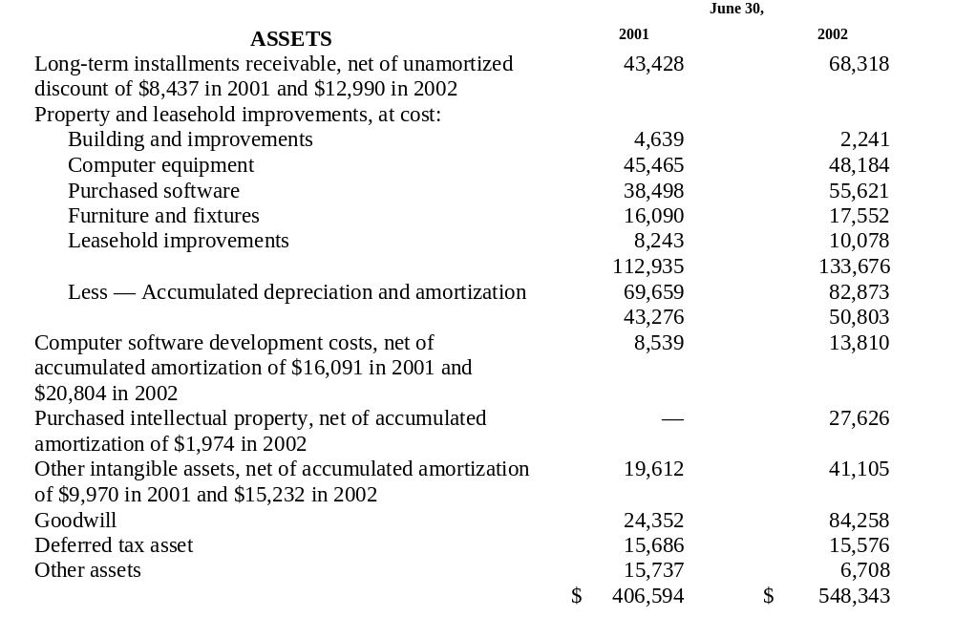
Fixed Assets
Notes:
Again – a long list of fixed assets.
Property, Plant and Equipment – listed at cost, sometimes grouped together – often broken out by category.
Accumulated Depreciation – sometimes listed by asset category – sometimes not. Note, in this case that its hard to tell which assets might be ready replacement.
Capitalized software development costs – basically the cost of building their software. Need to understand amortization schedule. This may be a soft asset depending on the product.
Purchased intellectual property – from acquisition. Again valuation mechanism is important.
Other intangible assets – usually purchased. Things like employment contracts, etc.
Goodwill – the difference between book value and acquisition cost. Beginning this year, company’s cannot depreciation. Instead each year they need to evaluate carrying cost. Watch out for big write-downs here – they many signal a division or product isn’t doing too well.
Note – total Assets increased about $150million – but the bulk of that came in intangible assets: Goodwill up $60m: Purchased software/property up $40m.

Slide 29
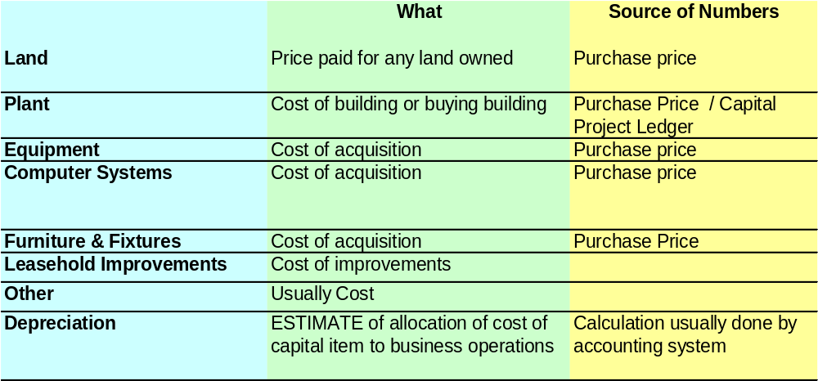
Dissecting the Balance Sheet – Left Side Thinking – Fixed Assets
Notes:
Capitalization Policies – vary widely (smaller items primarily)
Accounting Department Process
Purchase Price Allocation in M&A
Fixed Assets rarely audited (additions/deletions)
Depreciation Lives that reviewed
Other types of Assets: O&G Production, vehicles, airplanes, rolling stock, ski areas

Slide 30
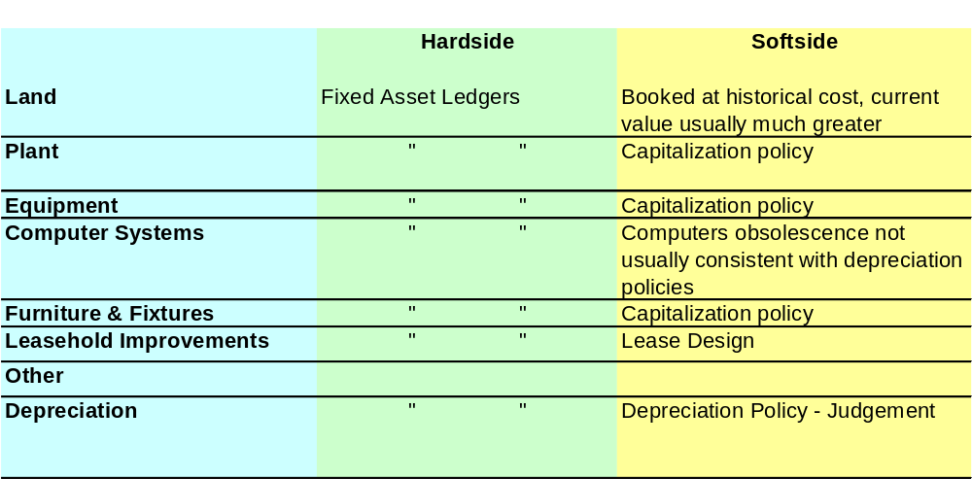
Dissecting the Balance Sheet – Left Side Thinking – Fixed Assets
Notes:
Capitalization Policies – vary widely (smaller items primarily)
Accounting Department Process
Purchase Price Allocation in M&A
Fixed Assets rarely audited (additions/deletions)
Depreciation Lives that reviewed
Other types of Assets: O&G Production, vehicles, airplanes, rolling stock, ski areas

Slide 31
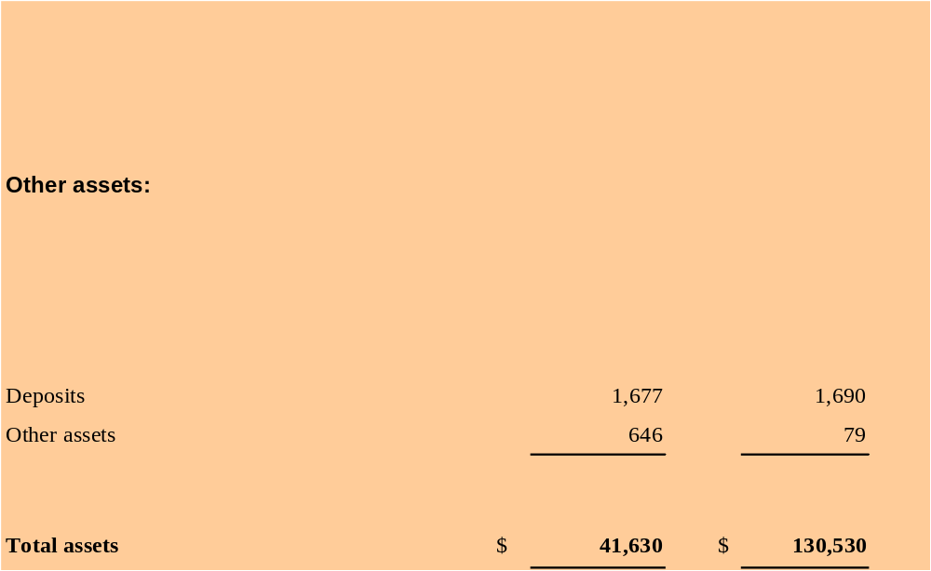
The Balance Sheet
Intangibles / Other Assets
Notes:
Normally people think of left side (assets) vs. right side (liabilities).
The most current assets/liabilities near the top with less liquid at bottom
MUST FOOT – easy, but watch for it.

Slide 32
Dissecting The Balance Sheet
LIABILITIES
Notes:
It should be 10:45AM

Slide 33
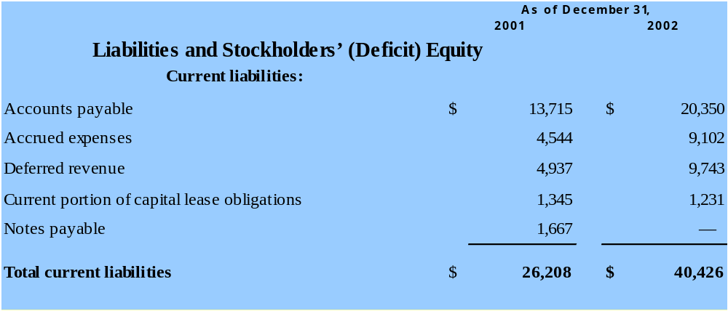
Current Liabilities
Notes:
Again – these are the debts due in the next 12 months.
Offensive Goal: Report liabilities in long-term to help current ratio
Talk about soft nature of unearned / deferred revenue
Accounts Payable – the normal day-to-day costs of running the business. Rent, phones, etc.
Accrued Expenses - items

Slide 34
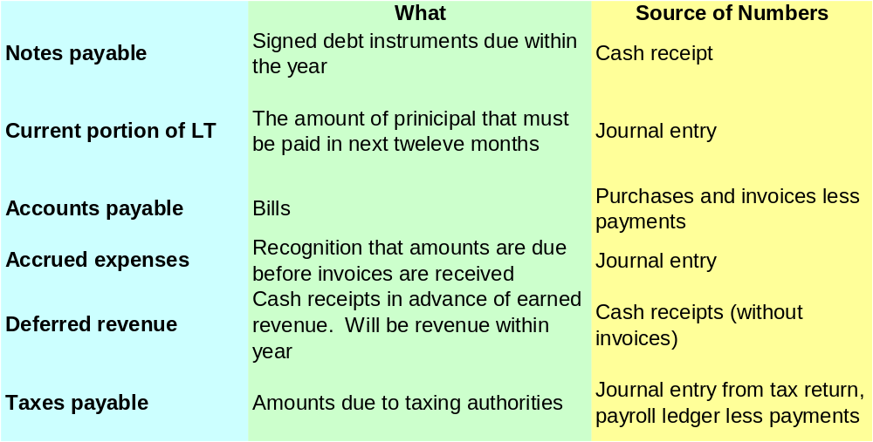
Dissecting the Balance Sheet
Right Side Thinking
Current Liabilities
Notes:
It should be 10:45
Deferred revenues are not a “true” liability. They are future revenue. I always make my bank count half against me. New conventions now require offset deferred costs.
Accruals are magical. Story of Ryan’s reserve…. Pressure to manage earnings, analysts….
Debt is usually the only thing objective

Slide 35
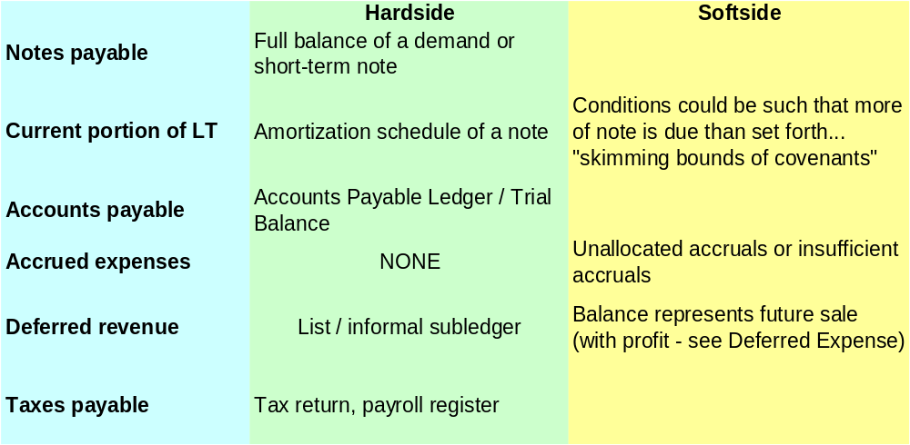
Dissecting the Balance Sheet
Right Side Thinking
Current Liabilities

Slide 36
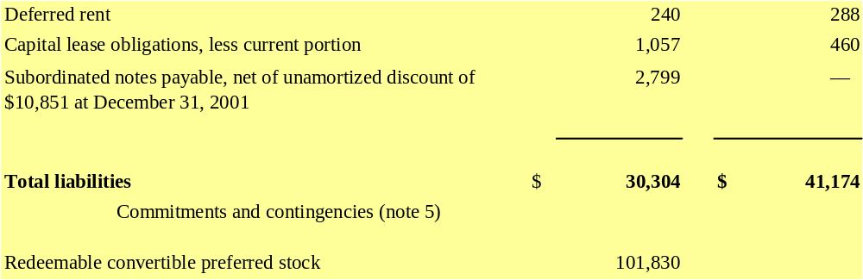
Long Term Liabilities

Slide 37
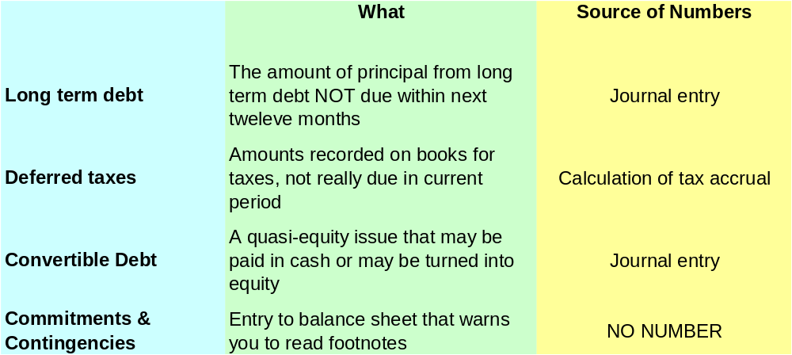
Dissecting the Balance Sheet – Right Side Thinking
Long-Term Liabilities

Slide 38
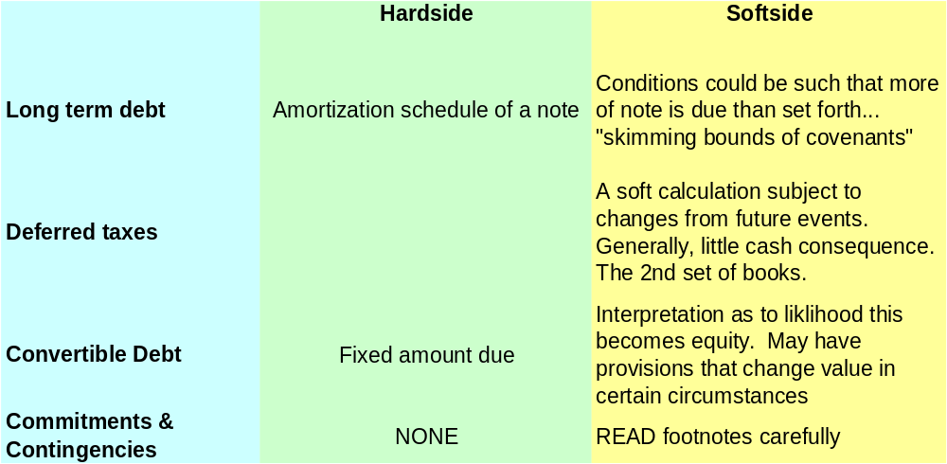
Dissecting the Balance Sheet – Right Side Thinking
Long-Term Liabilities
Notes:
Commitments and Contingencies is the balance sheet saying to you “Read the footnotes”
But then again, debt should also be telling you that

Slide 39
The Accounting Equation
Assets = Liabilities + Owner’s Equity

Slide 40
Effects of Business Transactions on Balance Sheet
Michael McBryan starts his automobiles repair business Over night Auto Service by selling 8000 shares of the small corporation to his family members at $ 10 per share

Slide 41
First Transaction by Michael McBryan on January 20, 2007 by opening company’s bank account by depositing $ 80,000 received from issuance of 8000 shares at $ 10 per share.

Slide 42
First Transaction by Michael McBryan on January 20, 2007 by opening company’s bank account by depositing $ 80,000 received from issuance of 8000 shares at $ 10 per share.
OVERNIGHT AUTO SERVICE
Balance Sheet
January 20, 2007
Assets
Cash……………… $ 80,000
Owner’s Equity
Capital Stock………………$ 80,000

Slide 43
On January 21, 2007 Overnight purchased land from city for $ 52,000 cash
OVERNIGHT AUTO SERVICE
Balance Sheet
January 20, 2007
Assets
Cash……………… $ 80,000
Owner’s Equity
Capital Stock………………$ 80,000

Slide 44
On January 21, 2007 Overnight purchased land from city for $ 52,000 cash
OVERNIGHT AUTO SERVICE
Balance Sheet
January 21, 2007
Assets
Cash……………… $ 28,000
Land………….. …$ 52,000
Total………… … $ 80,000
Owner’s Equity
Capital Stock…………………$ 80,000
Total……….……… ………….$ 80,000

Slide 45
On January 22, 2007 Overnight purchased old garage building from Metropolitan Transit Authority for $ 36,000. Overnight made a cash down payment of $ 6,000 and issued a 90-day non-interest bearing note payable for the $ 30,000 balance owed
OVERNIGHT AUTO SERVICE
Balance Sheet
January 21, 2007
Assets
Cash……………… $ 28,000
Land………….. …$ 52,000
Total………… … $ 80,000
Owner’s Equity
Capital Stock…………………$ 80,000
Total……….……… ………….$ 80,000

Slide 46
On January 22, 2007 Overnight purchased old garage building from Metropolitan Transit Authority for $ 36,000. Overnight made a cash down payment of $ 6,000 and issued a 90-day non-interest bearing note payable for the $ 30,000 balance owed
OVERNIGHT AUTO SERVICE
Balance Sheet
January 22, 2007
Assets
Cash……………… $ 22,000
Land………….. …$ 52,000
Building …………..$ 36,000
Total………… … $ 110,000
Liabilities & Owner’s Equity
Liabilities:
Notes Payable …………….…$ 30,000
Owner’s Equity:
Capital Stock…………………$ 80,000
Total……….……… ………….$110,000

Slide 47
On January 23, 2007 Overnight purchased tools and automotive repair equipment from Snap-On Tools Corp. The purchase price was $ 13,800 due with in 60 days.
OVERNIGHT AUTO SERVICE
Balance Sheet
January 22, 2007
Assets
Cash……………… $ 22,000
Land………….. …$ 52,000
Building …………..$ 36,000
Total………… … $ 110,000
Liabilities & Owner’s Equity
Liabilities:
Notes Payable …………….…$ 30,000
Owner’s Equity:
Capital Stock…………………$ 80,000
Total……….……… ………….$110,000

Slide 48
On January 23, 2007 Overnight purchased tools and automotive repair equipment from Snap-On Tools Corp. The purchase price was $ 13,800 due with in 60 days.
OVERNIGHT AUTO SERVICE
Balance Sheet
January 23, 2007
Assets
Cash………………… $ 22,000
Land………….. …….$ 52,000
Building ………………$ 36,000
Tools & Equipment…..$ 13,800
Total………… … ….. $ 123,800
Liabilities & Owner’s Equity
Liabilities:
Notes Payable …………….…$ 30,000
Accounts Payable ………..…$ 13,800
Total Liabilities ………….…..$ 43,800
Owner’s Equity:
Capital Stock…………………$ 80,000
Total……….……… ………….$123,800

Slide 49
On January 24, 2007 Overnight sold excess tools and automotive repair equipment to a neighboring business Ace Towing for $ 1,800, a price equal to Overnight’s cost. Ace Towing paid no down payment but agreed to pay the amount within 45 days.
OVERNIGHT AUTO SERVICE
Balance Sheet
January 23, 2007
Assets
Cash………………… $ 22,000
Land………….. …….$ 52,000
Building ………………$ 36,000
Tools & Equipment…..$ 13,800
Total………… … ….. $ 123,800
Liabilities & Owner’s Equity
Liabilities:
Notes Payable …………….…$ 30,000
Accounts Payable ………..…$ 13,800
Total Liabilities ………….…..$ 43,800
Owner’s Equity:
Capital Stock…………………$ 80,000
Total……….……… ………….$123,800

Slide 50
On January 24, 2007 Overnight sold excess tools and automotive repair equipment to a neighboring business Ace Towing for $ 1,800, a price equal to Overnight’s cost. Ace Towing paid no down payment but agreed to pay the amount within 45 days.
OVERNIGHT AUTO SERVICE
Balance Sheet
January 24, 2007
Assets
Cash………………… $ 22,000
Accounts Receivable $ 1,800
Land………….. …….$ 52,000
Building ………………$ 36,000
Tools & Equipment…..$ 12,000
Total………… … ….. $ 123,800
Liabilities & Owner’s Equity
Liabilities:
Notes Payable …………….…$ 30,000
Accounts Payable ………..…$ 13,800
Total Liabilities ………….…$ 43,800 Owner’s Equity:
Capital Stock…………………$ 80,000
Total……….……… ………….$123,800

Slide 51
On January 26, 2007 Overnight received $ 600 fro Ace Towing as partial settlement of its account receivable from Ace
OVERNIGHT AUTO SERVICE
Balance Sheet
January 24, 2007
Assets
Cash………………… $ 22,000
Accounts Receivable $ 1,800
Land………….. …….$ 52,000
Building ………………$ 36,000
Tools & Equipment…..$ 12,000
Total………… … ….. $ 123,800
Liabilities & Owner’s Equity
Liabilities:
Notes Payable …………….…$ 30,000
Accounts Payable ………..…$ 13,800
Total Liabilities ………….…$ 43,800 Owner’s Equity:
Capital Stock…………………$ 80,000
Total……….……… ………….$123,800

Slide 52
On January 26, 2007 Overnight received $ 600 fro Ace Towing as partial settlement of its account receivable from Ace
OVERNIGHT AUTO SERVICE
Balance Sheet
January 26, 2007
Assets
Cash………………… $ 22,600
Accounts Receivable $ 1,200
Land………….. …….$ 52,000
Building ………………$ 36,000
Tools & Equipment…..$ 12,000
Total………… … ….. $ 123,800
Liabilities & Owner’s Equity
Liabilities:
Notes Payable …………….…$ 30,000
Accounts Payable ………..…$ 13,800
Total Liabilities ………….…$ 43,800 Owner’s Equity:
Capital Stock…………………$ 80,000
Total……….……… ………….$123,800

Slide 53
On January 27, 2007 Overnight made a partial payment of $ 6,800 on its accounts payable to Snap-On Tools.
OVERNIGHT AUTO SERVICE
Balance Sheet
January 26, 2007
Assets
Cash………………… $ 22,600
Accounts Receivable $ 1,200
Land………….. …….$ 52,000
Building ………………$ 36,000
Tools & Equipment…..$ 12,000
Total………… … ….. $ 123,800
Liabilities & Owner’s Equity
Liabilities:
Notes Payable …………….…$ 30,000
Accounts Payable ………..…$ 13,800
Total Liabilities ………….…$ 43,800 Owner’s Equity:
Capital Stock…………………$ 80,000
Total……….……… ………….$123,800

Slide 54
On January 27, 2007 Overnight made a partial payment of $ 6,800 on its accounts payable to Snap-On Tools.
OVERNIGHT AUTO SERVICE
Balance Sheet
January 27, 2007
Assets
Cash………………… $ 15,800
Accounts Receivable $ 1,200
Land………….. …….$ 52,000
Building ………………$ 36,000
Tools & Equipment…..$ 12,000
Total………… … ….. $ 117,000
Liabilities & Owner’s Equity
Liabilities:
Notes Payable …………….…$ 30,000
Accounts Payable ………..…$ 7,000
Total Liabilities ………….…$ 37,000 Owner’s Equity:
Capital Stock…………………$ 80,000
Total……….……… ………… $ 117,000

Slide 55
On January 31, 2007 Overnight recorded sales of repair services of $ 2,200.
OVERNIGHT AUTO SERVICE
Balance Sheet
January 27, 2007
Assets
Cash………………… $ 15,800
Accounts Receivable $ 1,200
Land………….. …….$ 52,000
Building ………………$ 36,000
Tools & Equipment…..$ 12,000
Total………… … ….. $ 117,000
Liabilities & Owner’s Equity
Liabilities:
Notes Payable …………….…$ 30,000
Accounts Payable ………..…$ 7,000
Total Liabilities ………….…$ 37,000 Owner’s Equity:
Capital Stock…………………$ 80,000
Total……….……… ………… $ 117,000

Slide 56
On January 31, 2007 Overnight recorded sales of repair services of $ 2,200.
OVERNIGHT AUTO SERVICE
Balance Sheet
January 31, 2007
Assets
Cash………………… $ 18,000
Accounts Receivable $ 1,200
Land………….. …….$ 52,000
Building ………………$ 36,000
Tools & Equipment…..$ 12,000
Total………… … ….. $ 119,200
Liabilities & Owner’s Equity
Liabilities:
Notes Payable …………...$ 30,000
Accounts Payable ………...$ 7,000
Total Liabilities ………….………...$ 37,000 Owner’s Equity:
Capital Stock…………….$ 80,000
Retained Earnings……….$ 2,200 $ 82,200
Total……….……… …………….… $119,200

Slide 57
On January 31, 2007 Overnight paid $ 200 utilities and $ 1200 for wages to employees.
OVERNIGHT AUTO SERVICE
Balance Sheet
January 31, 2007
Assets
Cash………………… $ 18,000
Accounts Receivable $ 1,200
Land………….. …….$ 52,000
Building ………………$ 36,000
Tools & Equipment…..$ 12,000
Total………… … ….. $ 119,200
Liabilities & Owner’s Equity
Liabilities:
Notes Payable …………...$ 30,000
Accounts Payable ………...$ 7,000
Total Liabilities ………….………...$ 37,000 Owner’s Equity:
Capital Stock…………… $ 80,000
Retained Earnings……….$ 2,200 $ 82,200
Total……….……… …………….… $119,200

Slide 58
On January 31, 2007 Overnight paid $ 200 utilities and $ 1200 for wages to employees.
OVERNIGHT AUTO SERVICE
Balance Sheet
January 31, 2007
Assets
Cash………………… $ 16,600
Accounts Receivable $ 1,200
Land………….. …….$ 52,000
Building ………………$ 36,000
Tools & Equipment…..$ 12,000
Total………… … ….. $ 117,800
Liabilities & Owner’s Equity
Liabilities:
Notes Payable …………...$ 30,000
Accounts Payable ………...$ 7,000
Total Liabilities ………….………...$ 37,000 Owner’s Equity:
Capital Stock…………… $ 80,000
Retained Earnings……….$ 800 $ 80,800
Total……….……… …………….… $117,800

Slide 59
Expanded Accounting Equation

Slide 60
Income Statement
Summarization of company’s revenue and expense transactions for a period of time.
Revenues are increases in company’s assets from from it’s profit directed activities, and they result in positive cash flows.
Expenses are decreases in company’s assets from from it’s profit directed activities, and they result in negative cash flows.
Net Income is the difference between the revenues and expenses for a specified period of time.
Negative net income is known as net loss.

Slide 61
Income Statement
OVERNIGHT AUTO SERVICE
Income Statement
For the Period January 20–31, 2007
Sales Revenues……………………… 2,200
Operating Expenses:
Wages ………………………..1,200
Utilities ……………………… 200 1,400
Net Income ………………………….. 800

Slide 62
Statement of Cash Flows
Helps in understanding an enterprise for purposes of investment and credit decisions.
The statement of cash flows depicts the ways cash changed during a designated period.

Slide 63
Statement of Cash Flows
Cash flows are generated from three types of activities:
  Operating Activities
    Cash effects of revenues and expenses
  Investing Activities
    Cash effects of purchasing and selling assets
  Financing Activities
    Cash effects of owners investing in company and creditors loaning money to company

Slide 64
Statement of Cash Flows
  Negative Cash Flows
    Shown in parentheses
  Only those transactions which involve cash are shown in the statement

Slide 65
Statement of Cash Flows

Slide 66
Relationships among Financial Statements
Date at beginning of period
Date at end of period
Time
Statement of financial position (Balance sheet)
Income Statement
Statement of Cash Flows
Statement of financial position (Balance sheet)

